Slide 1
MAKİNE ÖĞRENMESİ
RAHİM KANSERİ SUNUMU

Slide 2
Kütüphane:
import pandas as pd
import numpy as np
import matplotlib.pyplot as plt
import seaborn as sns
import missingno as msno
from sklearn.experimental import enable_iterative_imputer
from sklearn.impute import IterativeImputer,SimpleImputer
from sklearn.preprocessing import LabelEncoder,OneHotEncoder
from sklearn.preprocessing import MinMaxScaler
from sklearn.model_selection import train_test_split, cross_validate, GridSearchCV
from sklearn.neighbors import KNeighborsClassifier
from sklearn.metrics import accuracy_score
from imblearn.over_sampling import SMOTE
from imblearn.under_sampling import NearMiss
from collections import Counter

Slide 3
df = pd.read_csv('/content/Uterine Corpus Endometrial Carcinoma.csv’)
df.head()
df.shape
df.info()
df.describe()
df.drop
df.rename
num_features =
Csv dosyası okunur.
İlk 5 satır gösterilir.
Verinin satır, sütun sayısını gösterir.
Hangi verilerde eksik olduğunu gösterir.
Verinin standart sapmasını hesaplar.
Gereksiz sütunları siler.
Yeni isim vermek için kullanılır.
Sayısal verileri alır.

Slide 4
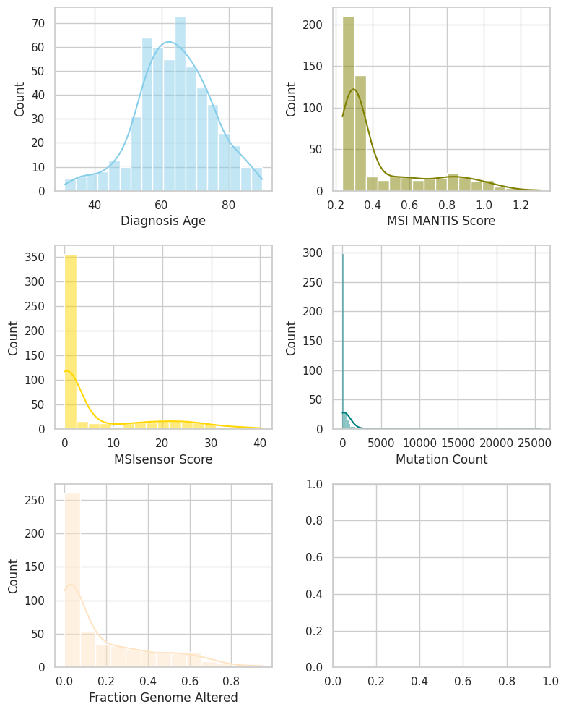
sns.set(style="whitegrid")
fig,axs = plt.subplots(3,2, figsize = (8, 10))
sns.histplot(data=final_df, x=num_features[0], kde=True, color="skyblue", ax=axs[0, 0])
sns.histplot(data=final_df, x=num_features[1], kde=True, color="olive", ax=axs[0, 1])
sns.histplot(data=final_df, x=num_features[2], kde=True, color="gold", ax=axs[1, 0])
sns.histplot(data=final_df, x=num_features[3], kde=True, color="teal", ax=axs[1, 1])
sns.histplot(data=final_df, x=num_features[4], kde=True, color="bisque", ax=axs[2, 0])
fig.tight_layout()
plt.show()

Slide 5
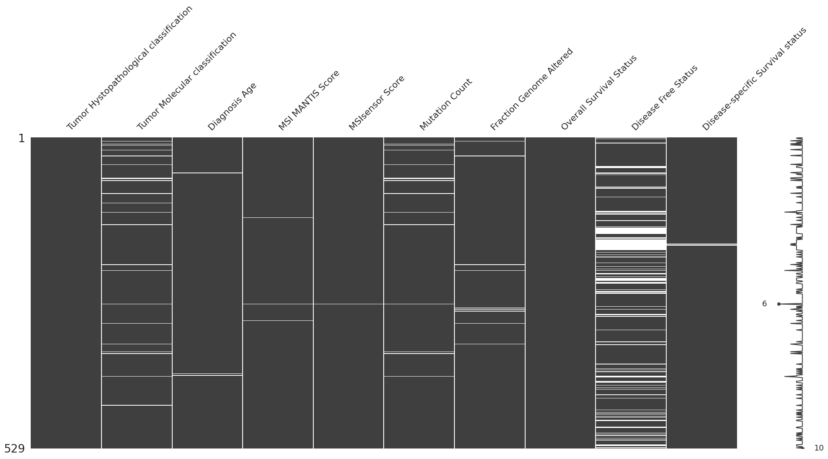
final_df.isna().sum()[Eksik veri tespitini yapar.]
msno.matrix(final_df)
plt.show()

Slide 6
mean_imputer = SimpleImputer(strategy='mean')
final_df['Diagnosis Age'] = mean_imputer.fit_transform(final_df[['Diagnosis Age']])
median_imputer = SimpleImputer(strategy='median')
final_df[['MSI MANTIS Score', 'MSIsensor Score', 'Mutation Count', 'Fraction Genome Altered']] = median_imputer.fit_transform(final_df[['MSI MANTIS Score', 'MSIsensor Score', 'Mutation Count', 'Fraction Genome Altered']])
Eksik verileri doldurur.
Ortalama ile doldurur. (strategy)
Sütun seçer,
Sütunun ortalamasını hesaplar,
Bu değerleri ortalama ile değiştirir.
Eksik verileri median(ortanca değer) ile doldurur.

Slide 7
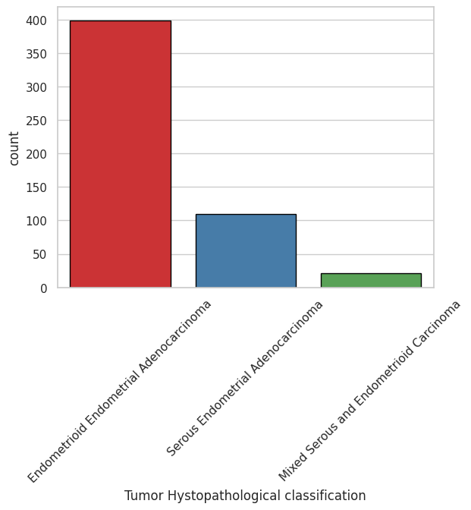
sns.countplot(x='Tumor Hystopathological classification', data=final_df, palette="Set1", edgecolor='black')
plt.xticks(rotation=45)
plt.show()

Slide 8
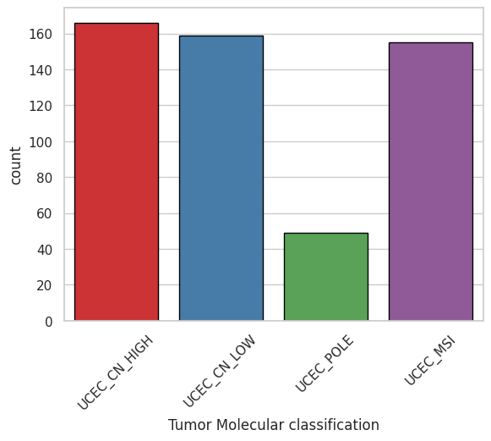
sns.countplot(x='Tumor Molecular classification', data=final_df, palette='Set1', edgecolor='black')
plt.xticks(rotation=45)
plt.show()

Slide 9
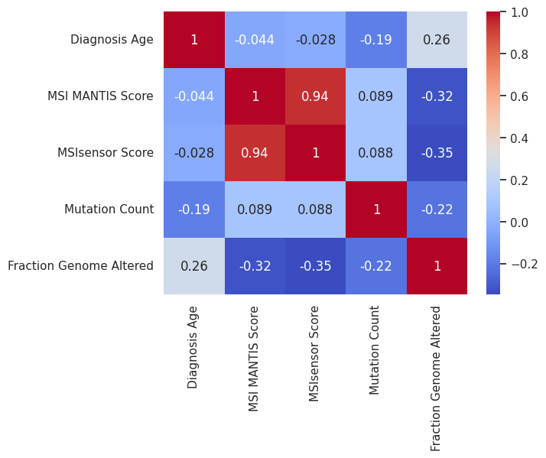
sns.heatmap(final_df.select_dtypes(exclude='object').corr(), annot=True, cmap='coolwarm')
plt.show()

Slide 10
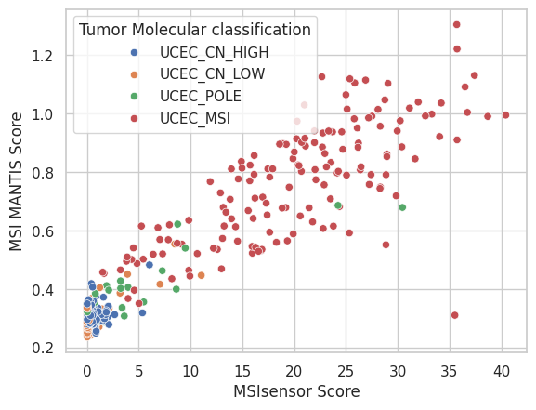
sns.scatterplot(data=final_df, x='MSIsensor Score', y='MSI MANTIS Score', hue='Tumor Molecular classification')

Slide 11
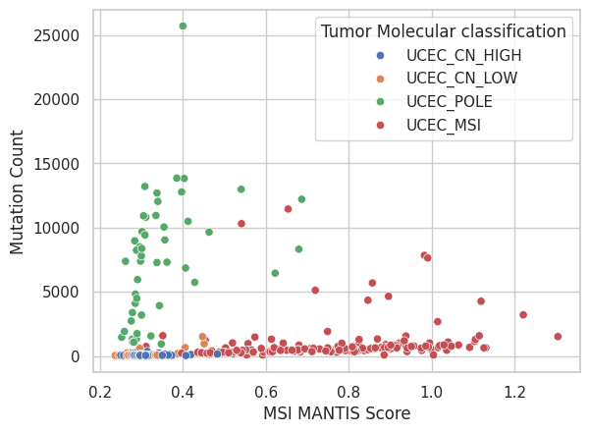
sns.scatterplot(data=final_df, x='MSI MANTIS Score', y='Mutation Count', hue='Tumor Molecular classification')

Slide 12
X = final_df[['Mutation Count', 'Fraction Genome Altered', 'MSI MANTIS Score', 'MSIsensor Score']]
y = final_df['Tumor Molecular classification']
Modelin öğreneceği girdiler (features)
Mutation Count → mutasyon sayısı
Fraction Genome Altered → genom değişim oranı
MSI MANTIS Score → genetik stabilite skoru
MSIsensor Score → MSI ölçümü
Modelin tahmin etmeye çalıştığı sonuç.

Slide 13
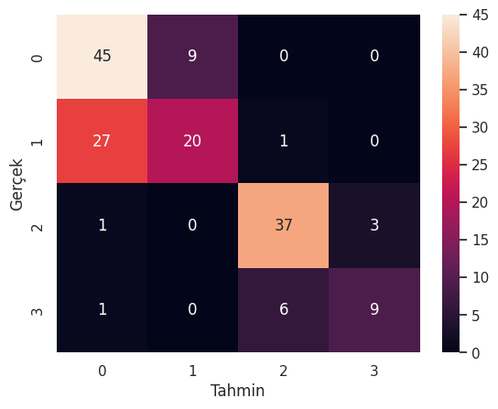
import seaborn as sns
from sklearn.metrics import confusion_matrix
cm = confusion_matrix(y_test, y_pred)
sns.heatmap(cm, annot=True, fmt="d")
plt.xlabel("Tahmin")
plt.ylabel("Gerçek")
plt.show()

Slide 14
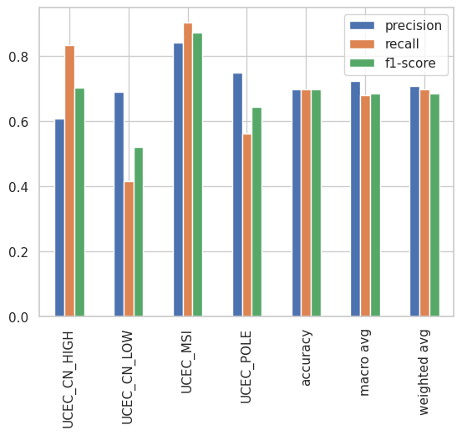
from sklearn.metrics import classification_report
import pandas as pd
report = classification_report(y_test, y_pred, output_dict=True)
df_report = pd.DataFrame(report).transpose()
df_report[['precision','recall','f1-score']].plot(kind='bar')
plt.show()

